Slide 1
Building Blocks of Animation
Hy-tech camp

Slide 2
Agenda
Icebreaker
History of 2D Animation
2D Video Game Animation
Kahoot Quiz
Piskel
Snap!

Slide 3
ICEBREAKER
Open Microsoft Paint
Draw a picture
Keep it appropriate please!
Share the picture with the group
Notes:
-Something they’d be willing to show their parents

Slide 4
History of 2D animation

Slide 5
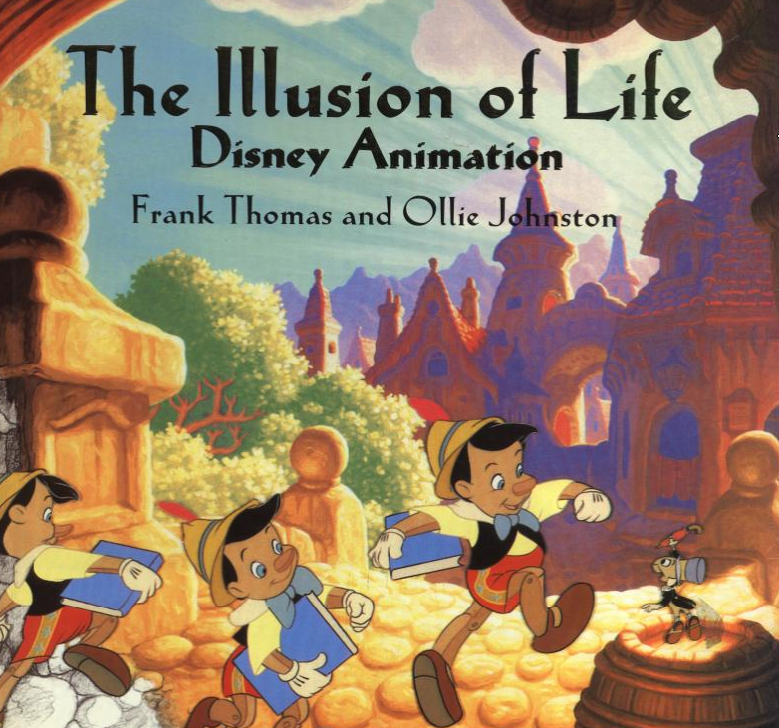
Animation (noun)
the state of being full of life or vigor; liveliness
OR
a method in which pictures are manipulated to appear as moving images… the illusion of life
Notes:
The idea is not to make things realistic; animators often exaggerate features or motion to make it appear more lively

Slide 6
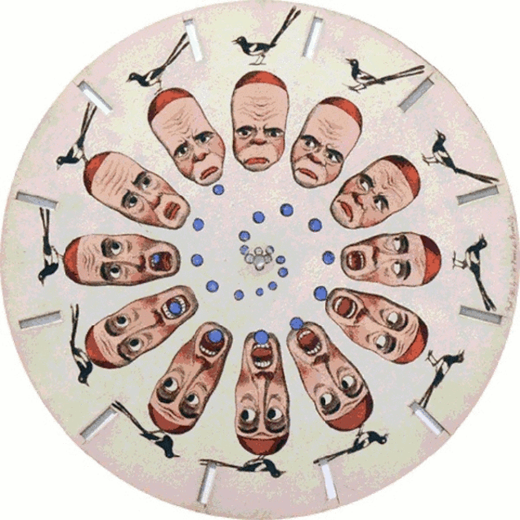
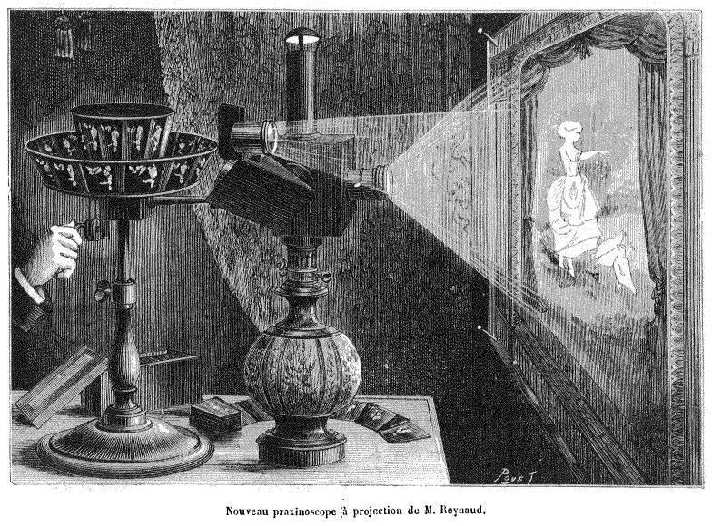
beginnings
Zoetrope (1834)
Praxinoscope (1877)
Notes:
Zoetrope in 1834 – sort of like a flip book

Slide 7

The first animated film (1906)
https://youtu.be/7M5So1WFNzo?t=80
Notes:
Students in the classroom could probably make something better than this

Slide 8
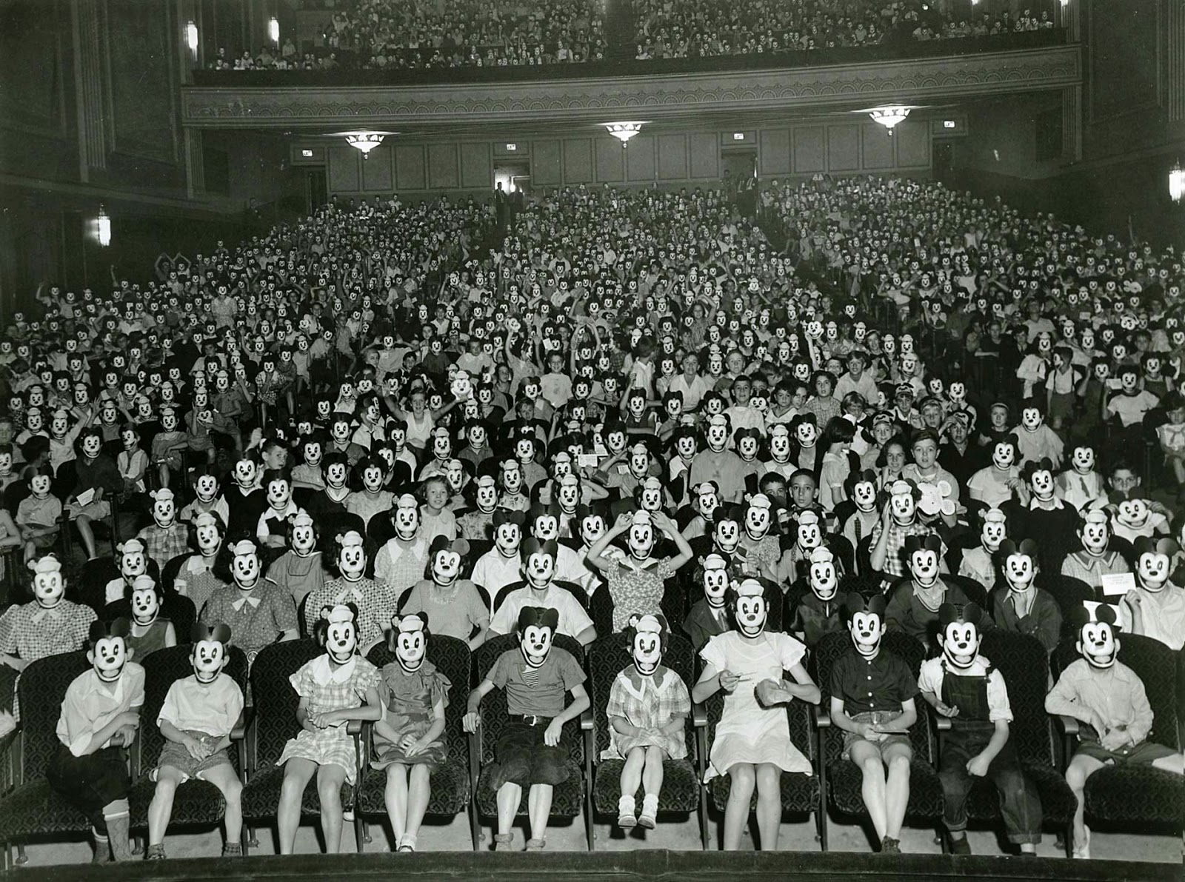
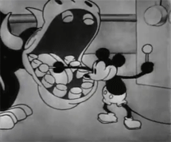
DISNEY
Steamboat Willie
Synchronized sound!
Mickey Mouse Craze
Notes:
Disney revolutionized animation in a lot of ways. Disney began with Mickey Mouse, an extremely popular character

Slide 9
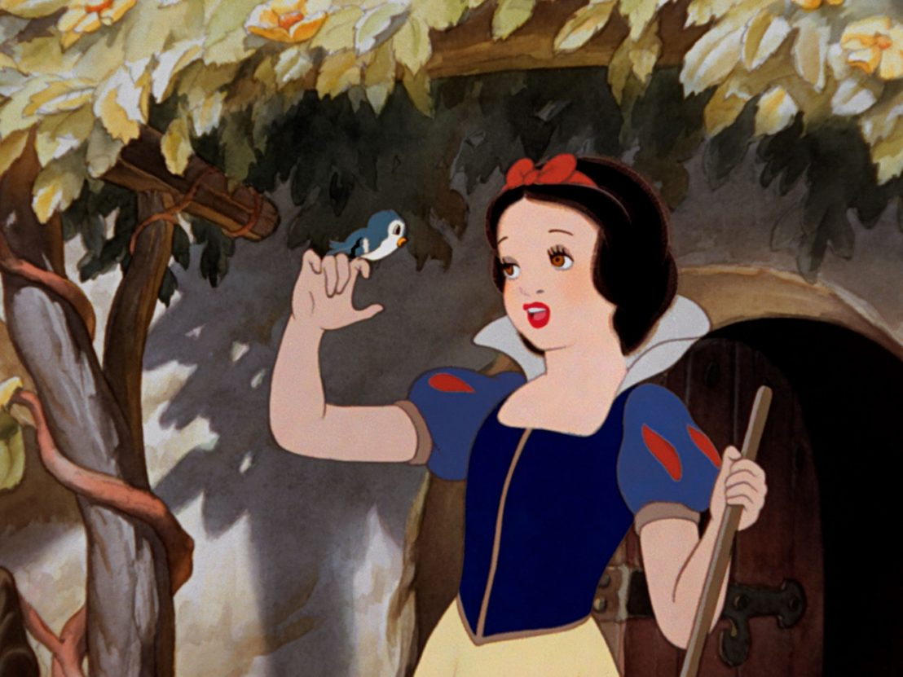
Feature-length animated films
Snow White was the first feature-length cel-animated film (1938)
Took a long time and cost a lot of money
Ultimately a huge success
Turned animation into an art form
Disney Innovations
Multiplane Camera
Rotoscoping
Interesting effects
Notes:
Snow White was a groundbreaking film. Ask the students if they have seen Snow White

Slide 10
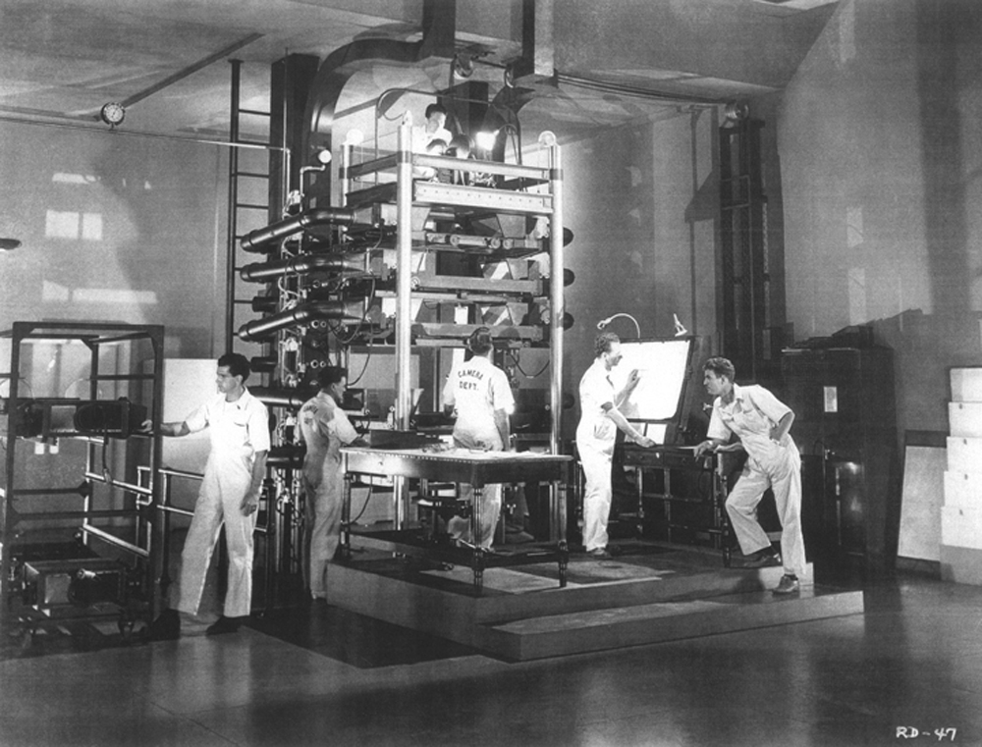
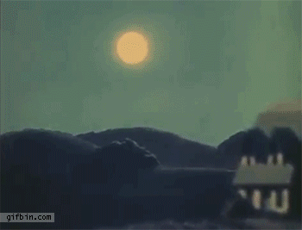
Multiplane camera
Multiple levels of cels allowed the artists to create the illusion of depth
Notes:
Everything was completely analog, done manually. They built this giant machine

Slide 11
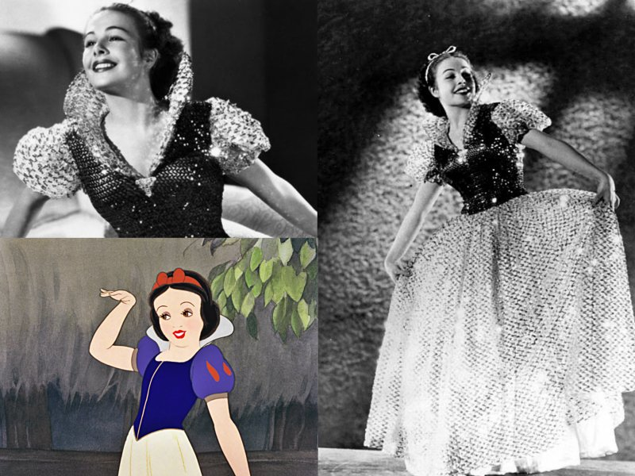
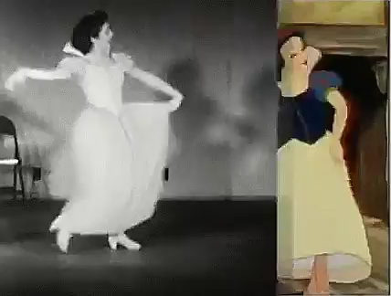
Rotoscoping
Disney would film the movements of real-life actors
Animators would trace the frames based on the movements

Slide 12
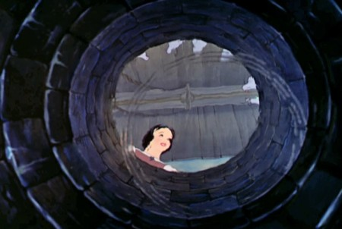
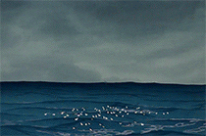
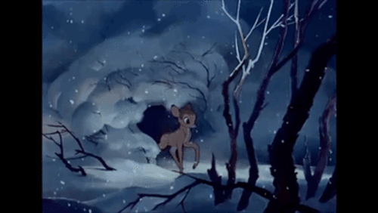
Interesting effects
Notes:
They used actual water to create a ripple effect, as if the camera were at the bottom of a well. Every frame had to be painted painstakingly

Slide 13
2D Video Game Animation

Slide 14
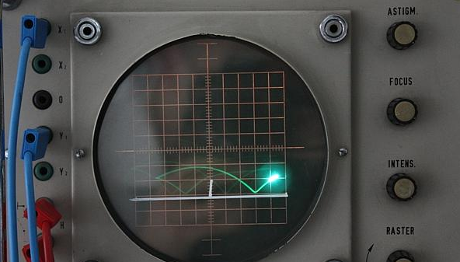
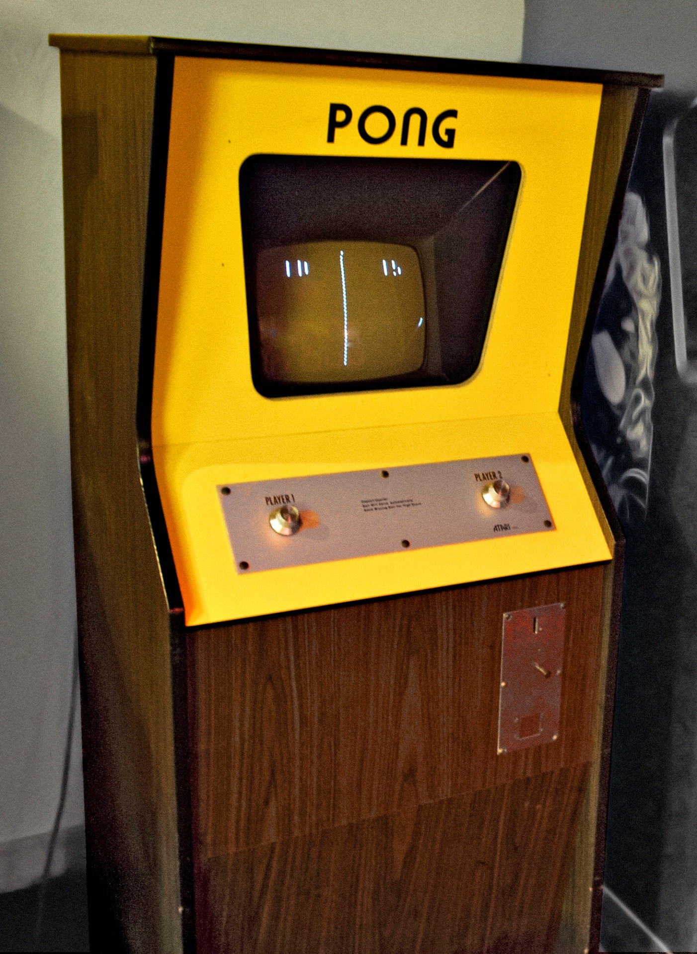
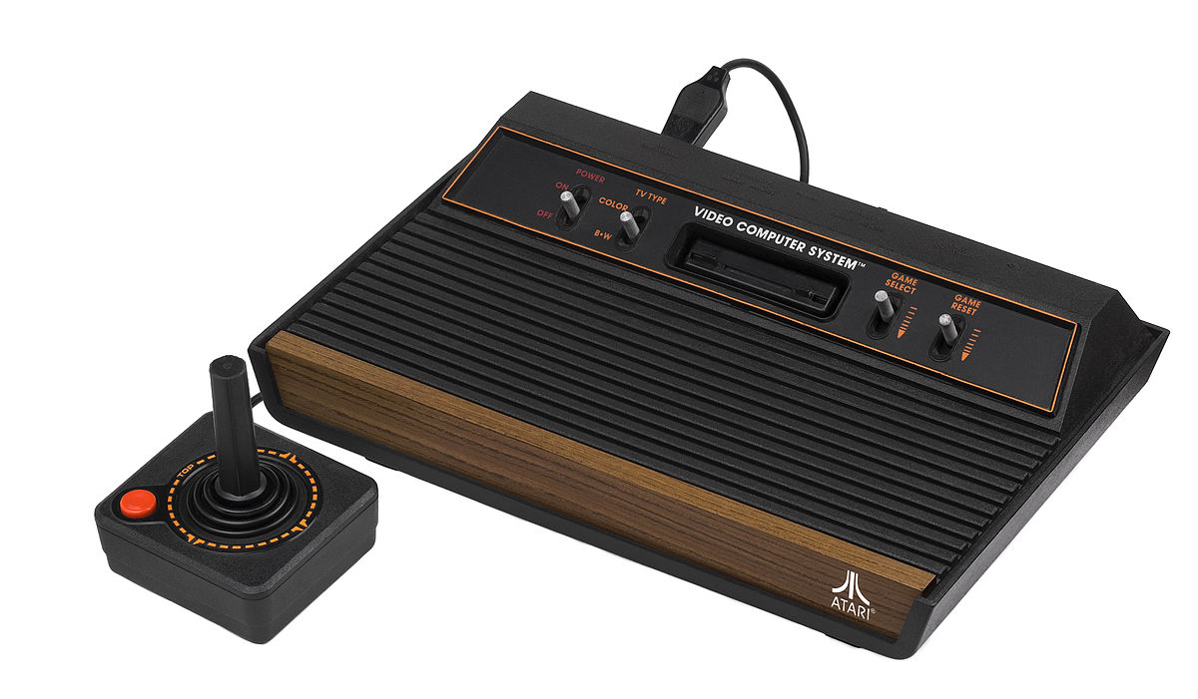
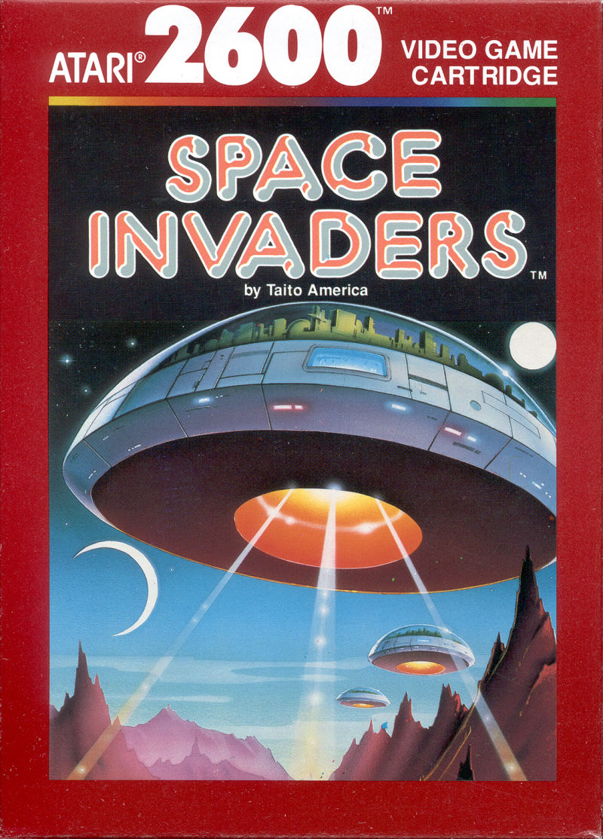
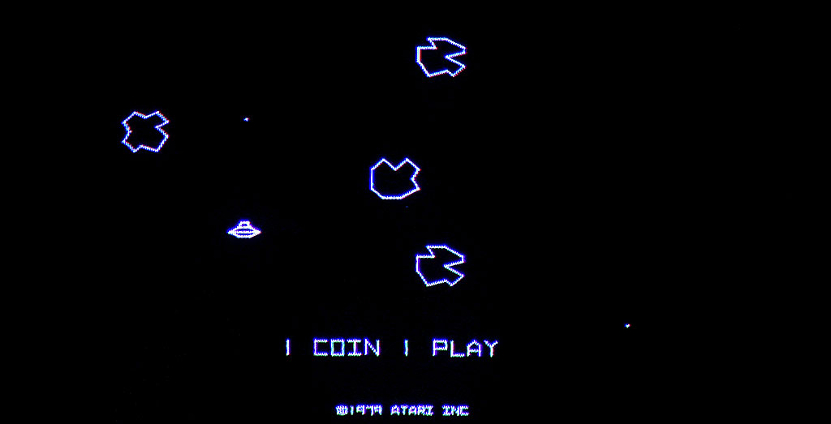
The first video games
Notes:
Pong was before Asteroids and Space Invaders. Does anyone know what these games are?

Slide 15
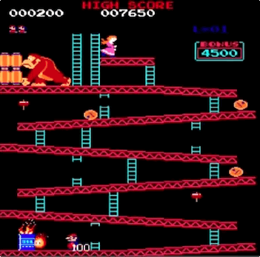
MARIO’s origins – Donkey Kong (1981)
Developed by Shigeru Miyamoto & Gunpei Yokoi
Inspired by Popeye, Beauty and the Beast, and King Kong
Mario was originally called Mr. Video / Jumpman
One of the earliest examples of the platformer genre
Groundbreaking graphics used for characterization / cut scenes
Notes:
The first game Mario appeared

Slide 16
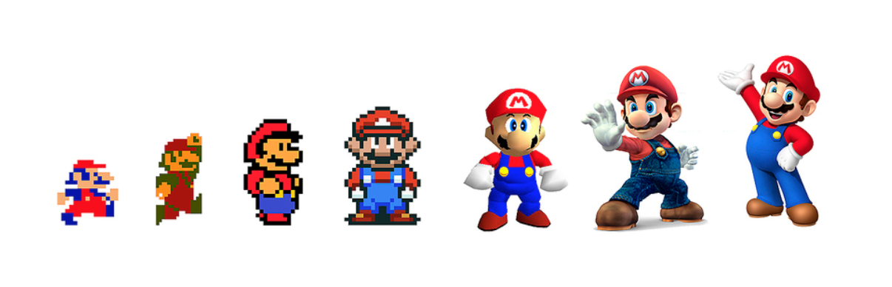
MARIO’s Evolution
Mario has changed a lot over the years…
… but people still love the original style, too
Notes:
Though times have changed, many people still like the old style

Slide 17
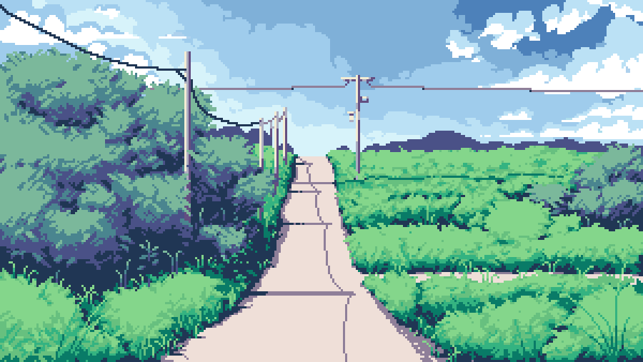

Pixel art
Though technology has evolved, many artists choose to copy this old style!
Notes:
Pixel art is popular these days because it has such a specific look and feel, it is nostalgic, and it is cheap

Slide 18
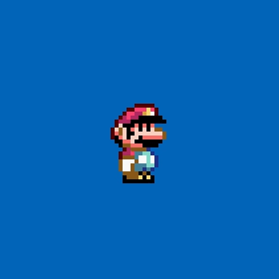
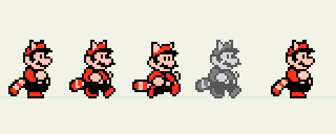
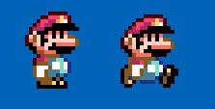
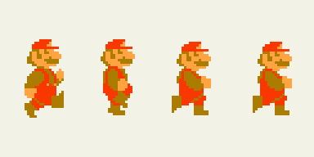
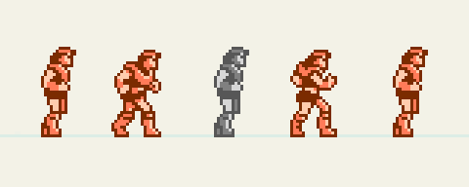
WALK cycles
2-frame (very simple)
“Ping-pong” reused frame
Classic 3-frame
Notes:
Walk cycles are simple in pixel art because of the limited number of pixels. These are some examples of walk cycles from video games

Slide 19
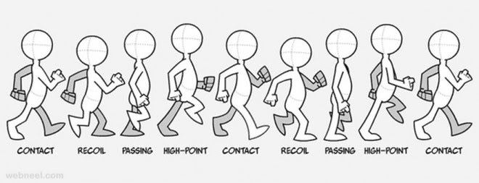
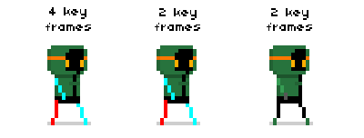
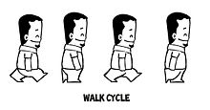
better walk cycles
More frames creates a smoother animation
Depending on the style of the game, it may be better to have fewer frames!
At least 3 frames is recommended
Notes:
It is possible to make smoother walk cycles, but sometimes simple is better

Slide 20
KAHOOT

Slide 21
Activities bit.ly/2XQQ3YF

